Slide 1


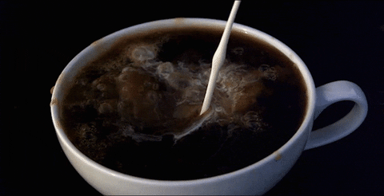

Introduction to Coffee
Coffee is one of the world's most popular beverages, enjoyed by millions of people every day. It is made from the roasted seeds of the coffee plant, which are known as coffee beans. Coffee has a rich history and complex flavor profile that has captivated people for centuries.
By Aditi Singh
ROLL No 021330624005

Slide 2

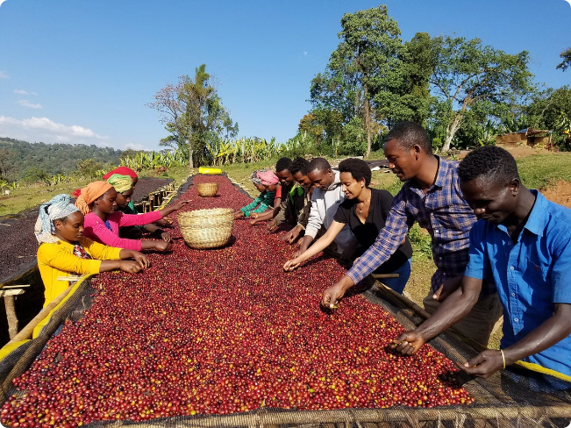
History and Origins
1
Origins
Coffee is believed to have originated in Ethiopia, where it was first cultivated as early as the 9th century.
2
Global Spread
From Ethiopia, coffee spread to the Middle East, and then to Europe and the Americas in the 17th and 18th centuries.
3
Modern Popularity
Today, coffee is grown in over 50 countries and is one of the most traded commodities in the world.

Slide 3
Coffee Production and Processing
Cultivation
Harvesting
Roasting
Coffee plants are grown in tropical and subtropical regions around the world, typically at high elevations.
Coffee cherries are hand-picked or machine-harvested, then processed to extract the coffee beans.
The coffee beans are roasted at high temperatures to develop their unique flavor and aroma.

Slide 4

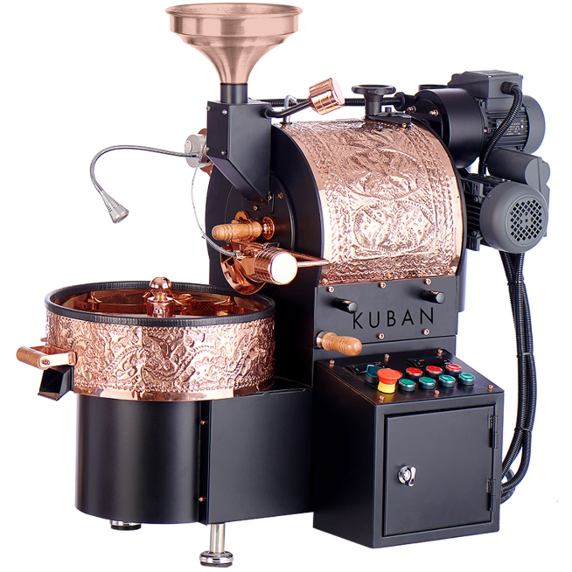
Raw Materials Required
1
Coffee Beans
The primary raw material for coffee is, of course, the coffee bean itself.
2
Water
Water is needed for the various stages of coffee production, from washing the cherries to brewing the final beverage.
3
Processing Equipment
Specialized equipment is required for tasks like roasting, grinding, and brewing the coffee.
4
Packaging Materials
Coffee beans and grounds must be packaged in airtight containers to preserve freshness and flavor.

Slide 5


Manufacturing Equipment
Grinder
Roaster
Brewer
Packager
Grinds the roasted coffee beans into a fine powder.
Heats and roasts the green coffee beans to develop their flavor.
Extracts the coffee essence by brewing the ground beans with hot water.
Packages the roasted and ground coffee into airtight containers.

Slide 6


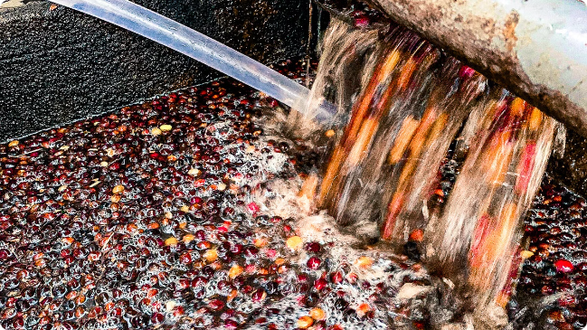


Transformation Process
Coffee Cherries
The coffee production process begins with the harvesting of coffee cherries from the plant.
Processing
The cherries are then processed, either by wet or dry methods, to extract the coffee beans.
Roasting
The extracted beans are then roasted at high temperatures to develop their unique flavor and aroma.

Slide 7

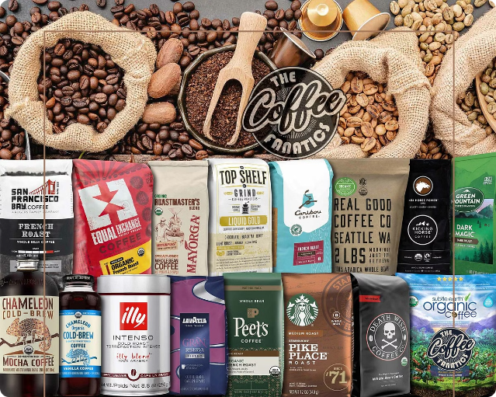
Finished Product
Whole Bean
Ground Coffee
Instant Coffee
Roasted coffee beans, perfect for grinding at home.
Finely ground roasted coffee, ready for brewing.
Dehydrated coffee powder, quickly dissolved in hot water.

Slide 8
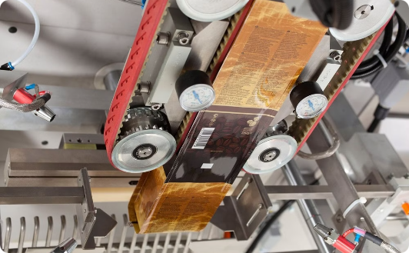
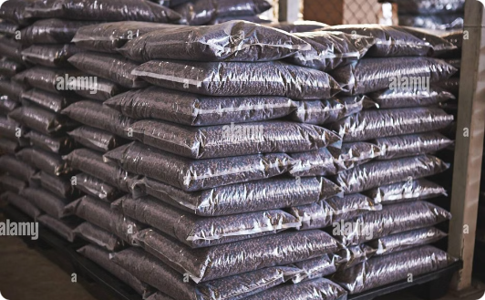
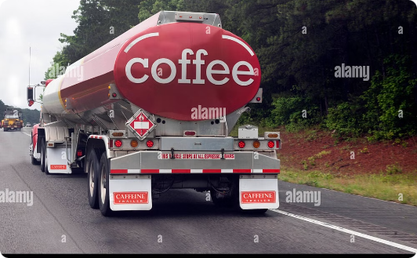
Packing and Logistics
Packaging
Warehousing
Transportation
Coffee is packaged in airtight bags or cans to preserve freshness and flavor.
Coffee is stored in temperature and humidity-controlled warehouses before distribution.
Coffee is shipped globally via trucks, trains, and cargo ships to reach consumers worldwide.

Slide 9

Inventory Management
1
Demand Forecasting
2
Just-in-Time Delivery
Careful analysis of consumer trends and market data is used to predict future coffee demand.
Coffee manufacturers and retailers aim to minimize inventory levels by using just-in-time delivery systems.
3
Quality Control
4
Traceability
Rigorous testing and quality checks are performed at every stage to ensure consistent product quality.
Advanced tracking and tracing systems allow for full visibility of the coffee supply chain.

Slide 10

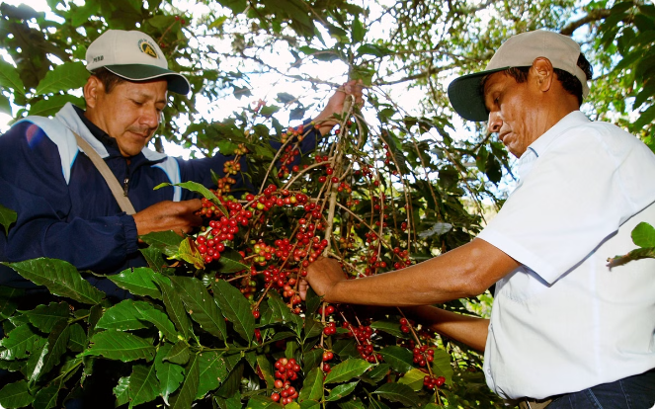
Conclusion and Future Trends
Sustainability
There is a growing focus on sustainable and ethical coffee production to protect the environment and support coffee farmers.
Specialty Coffee
Consumers are increasingly seeking out high-quality, single-origin coffee with unique flavor profiles and artisanal production methods.
Health Benefits
New research is discovering the potential health benefits of coffee, including its antioxidant properties and cognitive-enhancing effects.
Innovation
The coffee industry continues to innovate with new brewing methods, flavor profiles, and product offerings to meet evolving consumer demands.

Slide 11

Thank you

